Slide 1
Projeto individual Kimetsu no Yaiba
Here is where your presentation begins

Slide 2
CONTENTS OF THIS TEMPLATE
Here’s what you’ll find in this Slidesgo template:
A slide structure based on a marketing plan presentation, which you can easily adapt to your needs. For more info on how to edit the template, please visit Slidesgo School or read our FAQs.
An assortment of graphic resources that are suitable for use in the presentation can be found in the alternative resources slide.
A thanks slide, which you must keep so that proper credits for our design are given.
A resources slide, where you’ll find links to all the elements used in the template.
Instructions for use.
Final slides with:
The fonts and colors used in the template.
A selection of illustrations. You can also customize and animate them as you wish with the online editor. Visit Storyset to find more.
More infographic resources, whose size and color can be edited.
Sets of customizable icons of the following themes: general, business, avatar, creative process, education, help & support, medical, nature, performing arts, SEO & marketing, and teamwork.
You can delete this slide when you’re done editing the presentation.

Slide 3
TABLE OF CONTENTS
01
01
02
02
03
04
05
03
05
06
06
ABOUT US
MARKET ANALYSIS
You can describe the topic of the section here
You can describe the topic of the section here
MARKET ANALYSIS
CONTENT PLAN
You can describe the topic of the section here
You can describe the topic of the section here
BUDGET
KPI OVERVIEW
You can describe the topic of the section here
You can describe the topic of the section here

Slide 4
01
ABOUT US
You can enter a subtitle here
if you need it

Slide 5
AWESOME WORDS
AWESOME W

Slide 6
OUR
COMPANY
YOUR LOGO
Mercury is the closest planet to the Sun and the smallest one in the Solar System—it’s only a bit larger than the Moon

Slide 7
OUR EVOLUTION
Venus is the second planet from the Sun
Despite being red, Mars is a cold place
2016
2014
Jupiter is the biggest planet in the Solar System
2018

Slide 8
OUR EVOLUTION
Saturn is a gas giant and has sveral rings
Jupiter is the biggest planet in the Solar System
2022
2020
Neptune is the farthest planet from the Sun
2024

Slide 9
WHAT SETS US APART?
VENUS
MERCURY
MARS
Venus has a beautiful name and is the second planet from the Sun
It’s the closest planet to the Sun and the smallest in the Solar System
Despite being red, Mars is actually a cold place. It’s full of iron oxide dust

Slide 10
GUIDING PRINCIPLES
MERCURY
NEPTUNE
MARS

Slide 11
—SOMEONE FAMOUS
“This is a quote. Words full of wisdom that someone important said and can make the reader get inspired.”

Slide 12
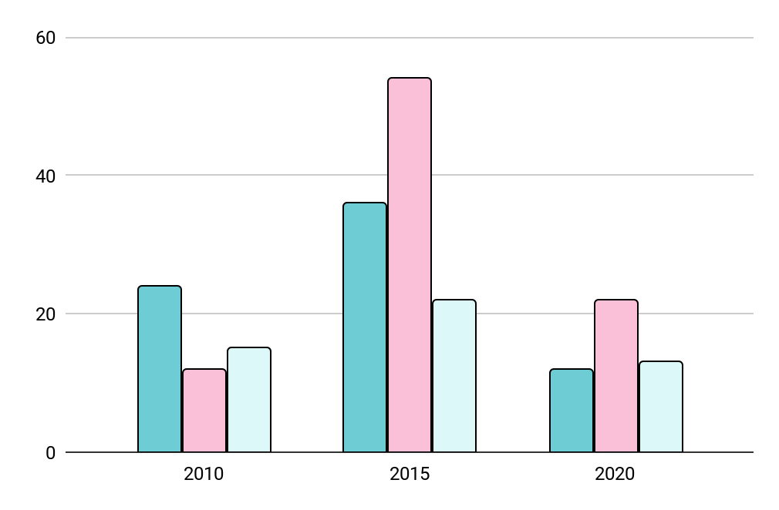
MARKET SHARE
MARS
Despite being red, Mars is a very cold place
VENUS
Venus has a beautiful name, but it’s terribly hot
SATURN
Follow the link in the graph to modify its data and then
paste the new one here. For more info, click here
Yes, this is the ringed one and it’s a gas giant

Slide 13
BUYER PERSONA PROFILE
WANTS PRIVACY
PRODUCT EXPERIENCES
Doesn’t share location
Blocks ads
01
Venus is terribly hot
02
Mars is a cold place
03
Saturn is a gas giant
OWNS A PROPERTY
SHOPPING CHOICES
VACATION TRIPS
INTERESTS
43%
Online
Venus
Aware of climate change
37%
Store
Mars
Loves animals
20%
Phone
Mercury
Has plants

Slide 14
BUYER JOURNEY
AWARENESS
Venus has a beautiful name and is the second planet from the Sun
CONSIDERATION
Jupiter is a gas giant and
the biggest planet in the Solar System
DECISION
Despite being red, Mars is actually a cold place. It’s full of iron oxide dust

Slide 15
SALES FUNNEL
AWARENESS
Jupiter is a gas giant and the biggest planet
INTEREST
Venus has a beautiful name, but it’s terribly hot
DECISION
Despite being red, Mars is a very cold place
PURCHASE
It’s composed mostly of hydrogen and helium

Slide 16
COMPETITOR ANALYSIS
MERCURY
MARS
Mercury is the closest planet to the Sun
Despite being red, Mars is a really cold place
JUPITER
SATURN
JUPITER
Saturn is composed of hydrogen and helium
Jupiter is the biggest planet in the Solar System

Slide 17
SWOT ANALYSIS
Despite being red, Mars is a cold place
Venus is the second planet from the Sun
STRENGTHS
OPPORTUNITIES
S
W
O
T
WEAKNESSES
THREATS
It’s the closest planet to the Sun
Saturn is a gas giant and has rings

Slide 18
GOALS
SHORT TERM
LONG TERM
GOAL 1
GOAL 2
GOAL 3
GOAL 4
Jupiter is the
biggest planet of them all
Saturn is mostly composed of
and helium
Despite being red, Mars is a cold place
Mercury is the closest planet to the Sun

Slide 19
STRATEGY
01
01
02
01
03
04
GOAL
KEY ACTION 1
MERCURY
Mercury is the closest planet to the Sun
Neptune is the
fourth-largest planet in
The Solar System
Earth is the only planet that harbors life
JUPITER
It’s a gas giant and the biggest planet
KEY ACTION 2
SATURN
Saturn is a gas giant and has rings
Venus has a beautiful name and is the second planet from the Sun
MARS
Mars is actually a very cold place

Slide 20
KEY ACTION ITEMS
 | FIRST QUARTER | SECOND QUARTER | THIRD QUARTER
Key Action 1 | Here you can describe your items for the first quarter | Here you can describe your items for the second quarter | Here you can describe your items for the third quarter
Key Action 2 | Here you can describe your items for the first quarter | Here you can describe your items for the second quarter | Here you can describe your items for the third quarter
Key Action 3 | Here you can describe your items for the first quarter | Here you can describe your items for the second quarter | Here you can describe your items for the third quarter

Slide 21
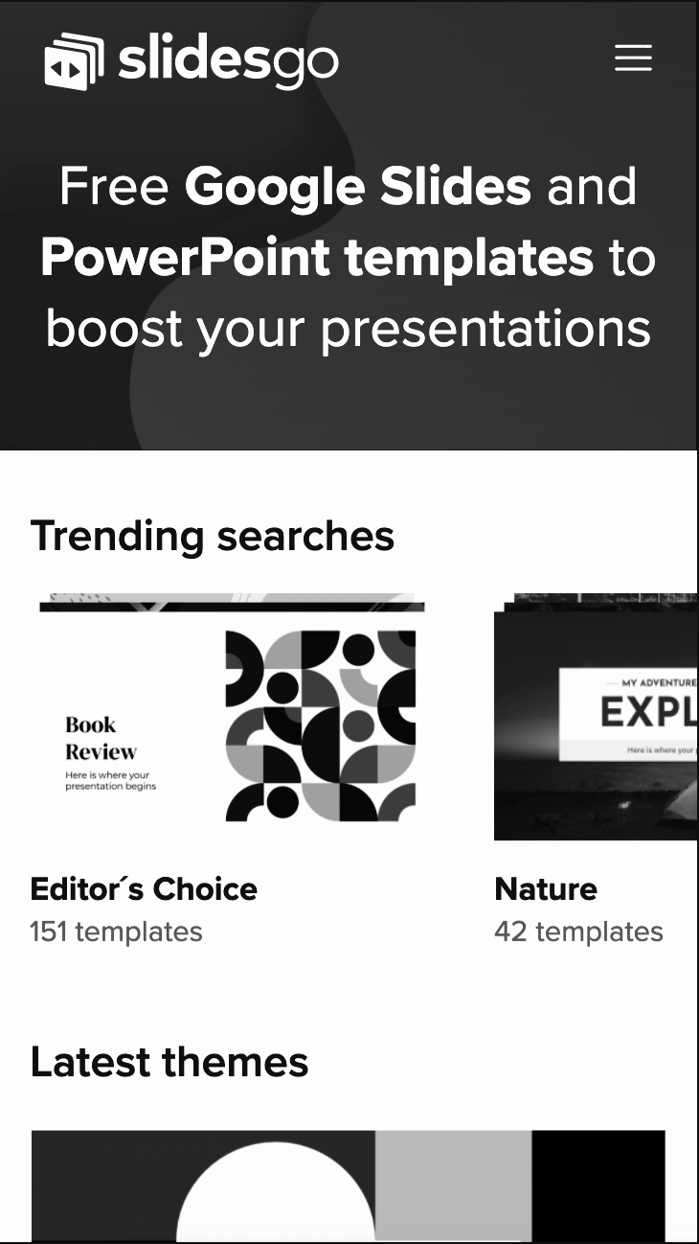
MOBILE WEB
MOBILE
WEB
You can replace the image on the screen with your own work. Just right-click on it and select “Replace image”

Slide 22
NEXT SPRINT
WEEK 2
Saturn is the ringed one. It’s a gas giant
Despite being red, Mars is a cold place
DAY 1
DAY 5
DAY 2
DAY 4
DAY 3
Mercury is the closest planet to the Sun
Venus is the second planet from the Sun
Saturn is a gas giant and has several rings

Slide 23
BUDGET
35%
MERCURY
10%
20,000,000
SUN
15%
QUARTERLY
BUDGET
VENUS
20%
20%
MARS
JUPITER

Slide 24
9h 55m 23s
333,000.000
386,000 km
Is Jupiter's
rotation period
Earths is the Sun’s mass
Is the distance between Earth and the Moon

Slide 25
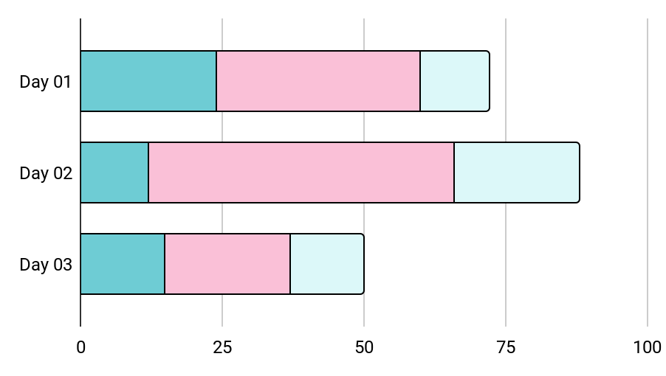
KPI OVERVIEW
COMPLIANCE RATE
PRODUCTIVITY
Mercury is the closest planet to the Sun
50%
Despite being red, Mars is a cold place
Venus
Mars
Mercury
70%
Follow the link in the graph to modify its data and then paste the new one here. For more info, click here

Slide 26
OUTREACH
JUPITER
It’s a gas giant and the biggest planet
SATURN
Saturn is composed mostly of hydrogen and helium
MARS
Mars is actually a very
cold place

Slide 27
REVIEWING CONCEPTS IS A GOOD IDEA
MARS
EARTH
Mars is actually a
very cold place
Despite being red, Mars is actually a cold place
It’s the closest planet to the Sun
Earth is the planet where we all live on
VENUS
SATURN
It’s the farthest planet
from the Sun
Venus is the second planet from the Sun
Saturn is the ringed one and a gas giant
Saturn is composed of hydrogen and helium
NEPTUNE
JUPITER
Neptune is the farthest
planet from the Sun
Neptune is the farthest planet from the Sun
Jupiter is the biggest planet of them all
Jupiter is the biggest
planet of them all

Slide 28
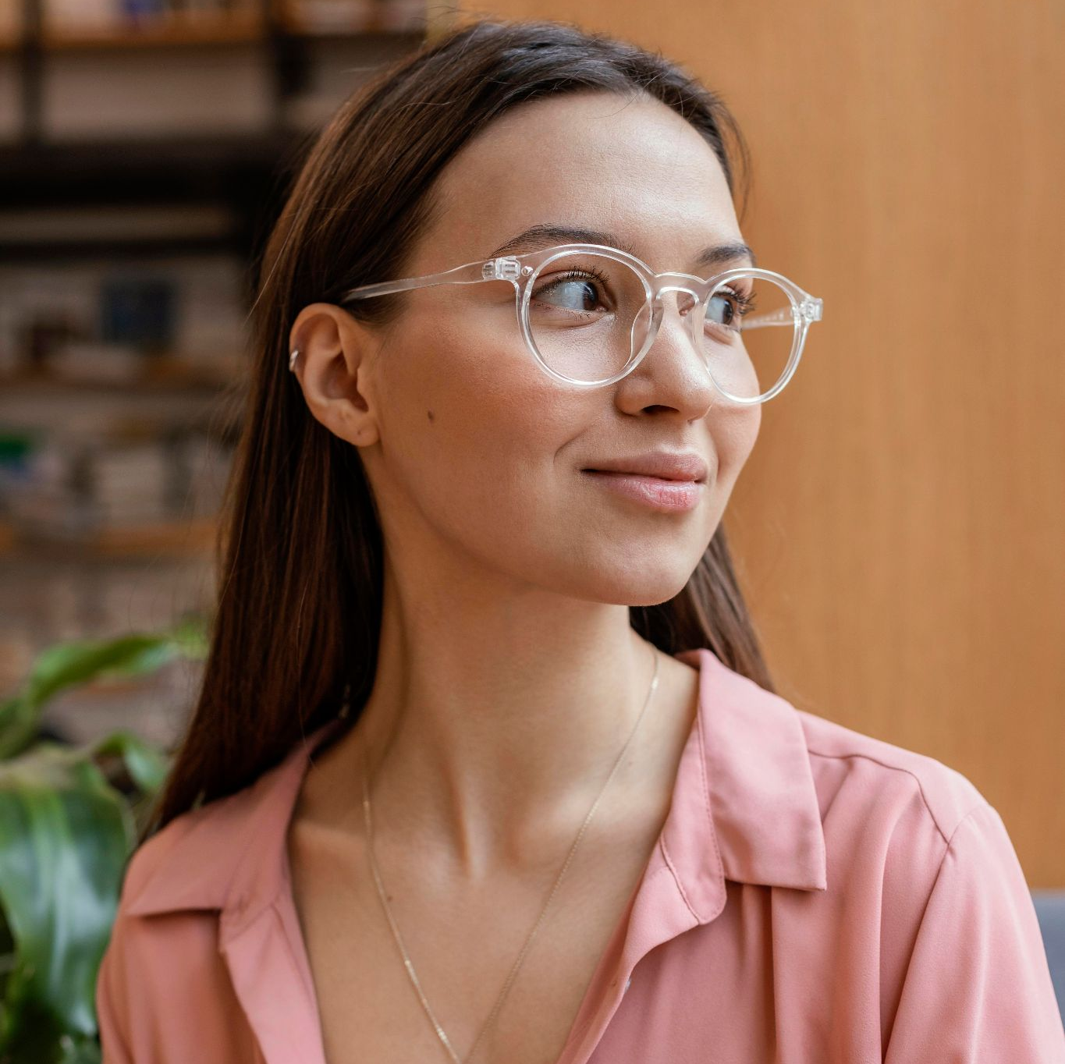

OUR TEAM
JENNA DOE
TIMMY JIMMY
You can talk a bit about this person here
You can talk a bit about this person here

Slide 29
THANKS!
DO YOU HAVE ANY QUESTIONS?
addyouremail@freepik.com
+91 620 421 838
yourcompany.com
Please keep this slide for attribution

Slide 30
ALTERNATIVE RESOURCES
Here’s an assortment of alternative resources whose style fits that of this template
PHOTOS
Team meeting startups
Entrepreneurs meeting at office
Teamwork meeting with business people
Businessman at office with laptop
VECTORS
Landing page anime comic style template
Anime comic style template poster
Anime comic style banner template

Slide 31
RESOURCES
Did you like the resources on this template? Get them for free at our other websites
VECTORS
Banner anime comic style template
Anime comic style social media post template
Anime comic style template banner
Anime comic style banner template
PHOTOS
Entrepreneurs meeting
Woman writing business idea
Man writing business idea
Portrait young entrepreneur woman
Low angle businessman

